Slide 1

Employee Absenteeism Clustering
Mini Project-01

Slide 2
Frequency of Reason for the absenteeism.
Agenda :
Business Oriented.
Technical Oriented.

Slide 3
Business Oriented.

Slide 4
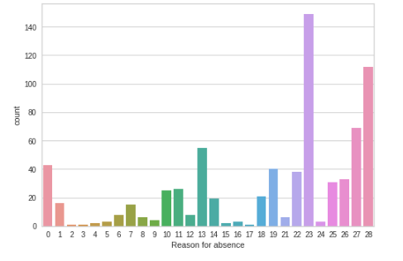
Frequency of Reason for the absenteeism.
(23,) Reason for the absenteeism is more frequently recorded i.e most common reason.

Slide 5
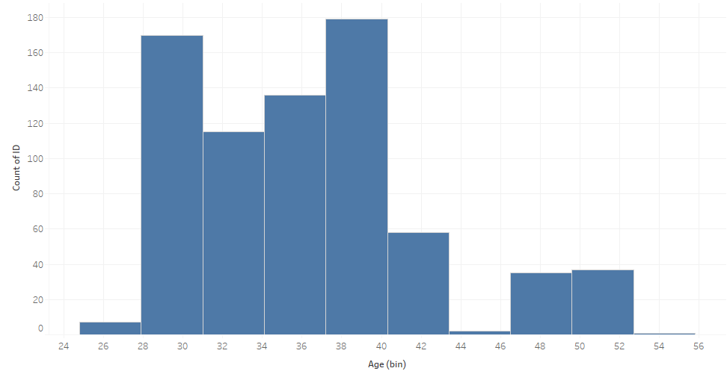
Distribution of age with respect to frequency of absenteeism.
Data is right skewed where most of the data is on the right side.
Employee absenteeism is more in the age group between 28-31 and 37-40 years.

Slide 6
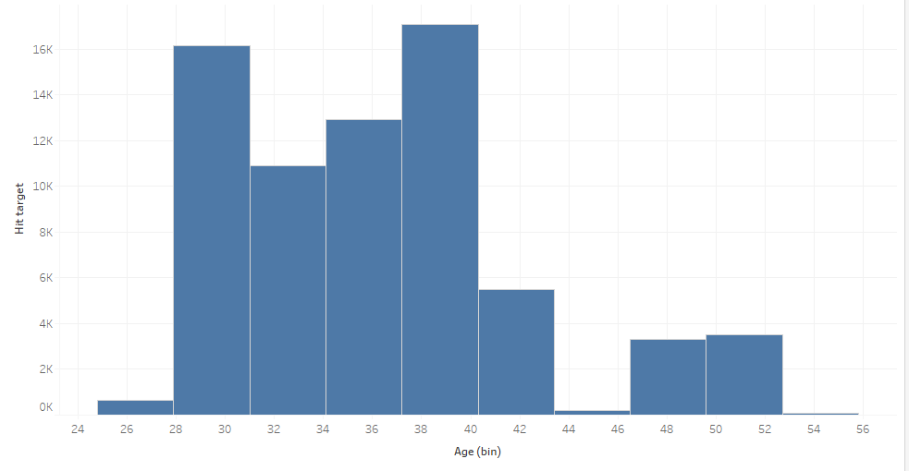
Distribution of age with respect to frequency of absenteeism.
Employees in the age group between 27-30 and 36-39 years reaching more targets.

Slide 7
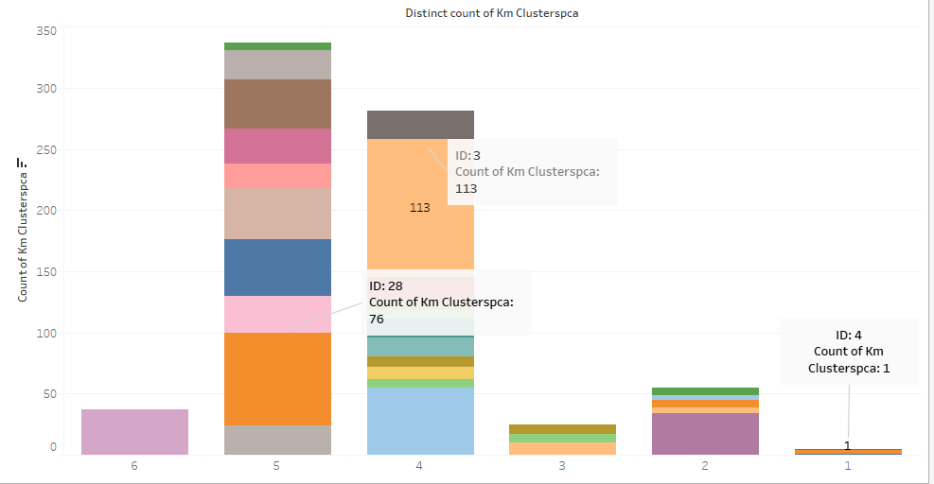
Employees Absenteeism Clusters(or groups)
Employees’ Absenteeism is more in the 5th cluster.
Employees’ Absenteeism is the least in 1st cluster.
Employee Id 3 has more absenteeism in the company.
Employee Id 4 has the least absenteeism in the company.

Slide 8
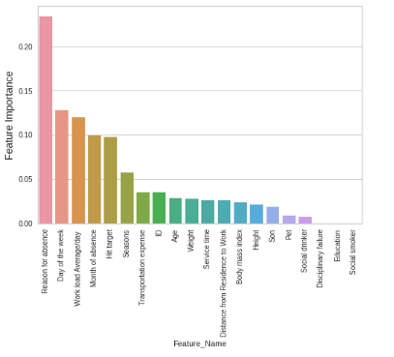
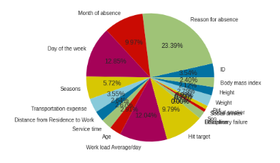
Employees Absenteeism Clusters(or groups)
Feature Importance

Slide 9
Suggestion
Look what is this reason (23,) and aid them with a solution or strategy in order to overcome absenteeism with the reason (23,).
Employees absenteeism is more in 4th and 5th cluster. Set up a meeting with a employees and do a follow-up.
Except for employees whose age is between 27-30 and 36-39 Since they are Contributing the highest Hit-Targets.

Slide 10
Technical Oriented

Slide 11
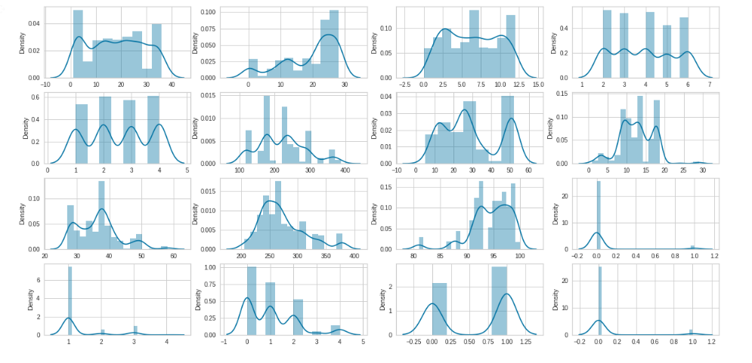

Employee Absenteeism Data Is Normally Distributed

Slide 12
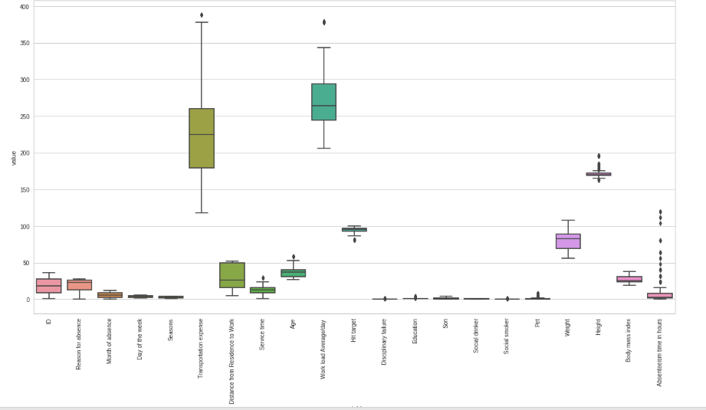
Outliers in Dataset

Slide 13
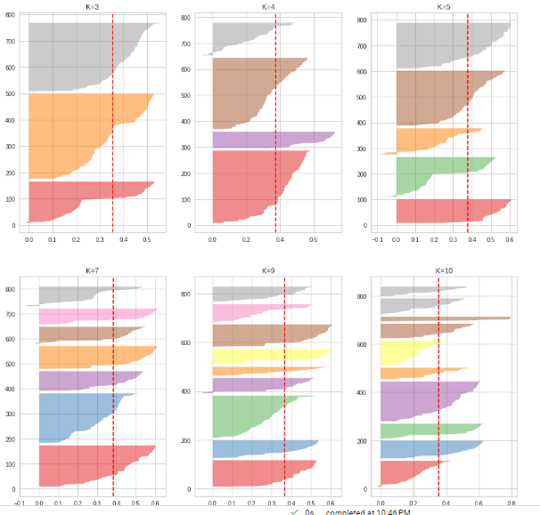
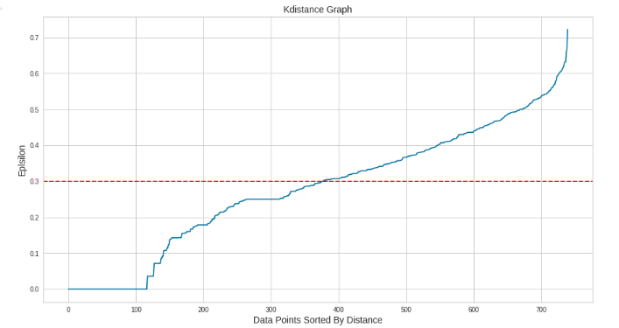
Exploratory Data Analysis (EDA)
silhouette VISUALIZER FOR k-MEANS
K-Distance graph for dbscan

Slide 14
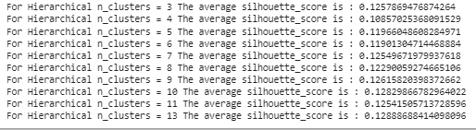
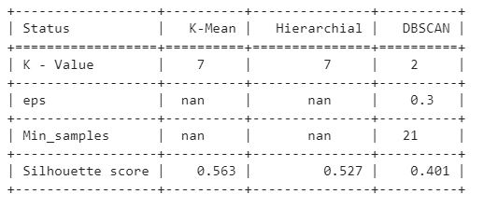
Exploratory Data Analysis (EDA)
Interpretation
K-Means Clustering is giving the best silhouette score.
Click here to see clusters-wise data.

Slide 15


Thank You

